Slide 1

APT Project Presentation
Nexalud Team
Members: Martín Casas, Alvaro Figueroa and Sergio Aracena
Section: 004D.

Slide 2
A 133% Increase
In patients on waiting lists
31% Growth
In surgeries performed from 2018–2023
Urgent Need
Improve medical care and patient flow within the health system
PUCV, 2024
PUCV, 2024

Slide 3





Added Value
Impact on Digital Health
Text
Text
Comprehensive Management
Operational Efficiency
User Impact
APT Project Platform
Patient Experience
Process Optimization
Automated management of medical interventions.
Patient Traceability
Time
Resource Control
Reduced waiting times
"Effective Monitoring"

Slide 4
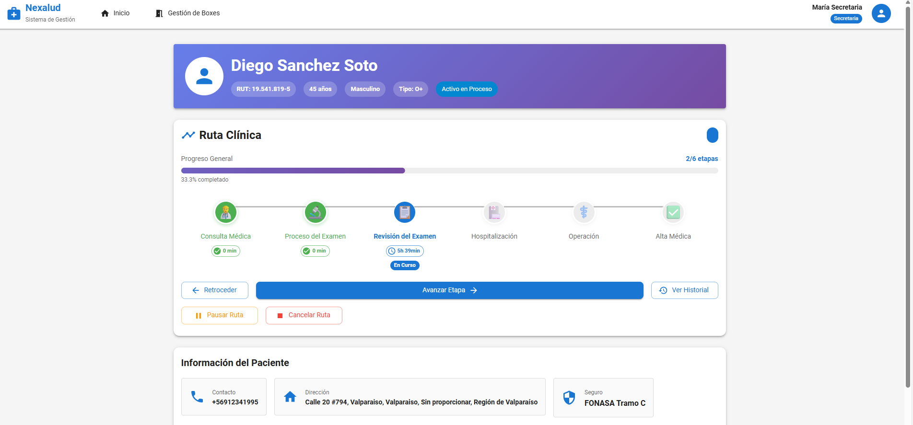
Nexalud medical management system
Nexalud is a system that allows tracking the patient's journey and reducing the uncertainty of waiting for care.
In addition, it will allow the collection of information about service times and space usage based on the collected metrics.

Slide 5

Competencies and Areas
Environment management
Big Data
IT solutions
System development
Fullstack
Machine Learning
Graduate Profile
Areas of performance
Solutions architecture
Data transformation and management
Infrastructure
Database
Implementation
Deployment

Slide 6

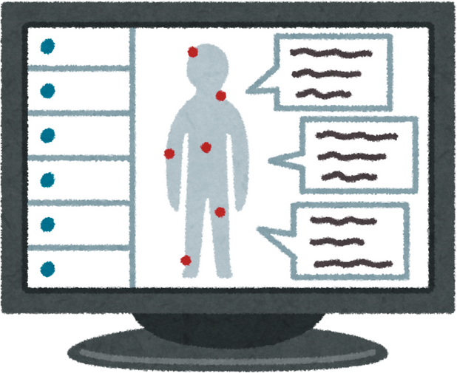





Project Objectives
Presenting the key objectives of the nexalud project
Specific Objectives
Visualize the progress status of each patient
Facilitate administrative management for secretaries and support staff
General Objective
Develop a system that optimizes waiting times and patient follow-up in health centers.
Real-time monitoring of patients and treatment rooms within the system
Reducing uncertainty during waiting times to increase patient satisfaction

Slide 7
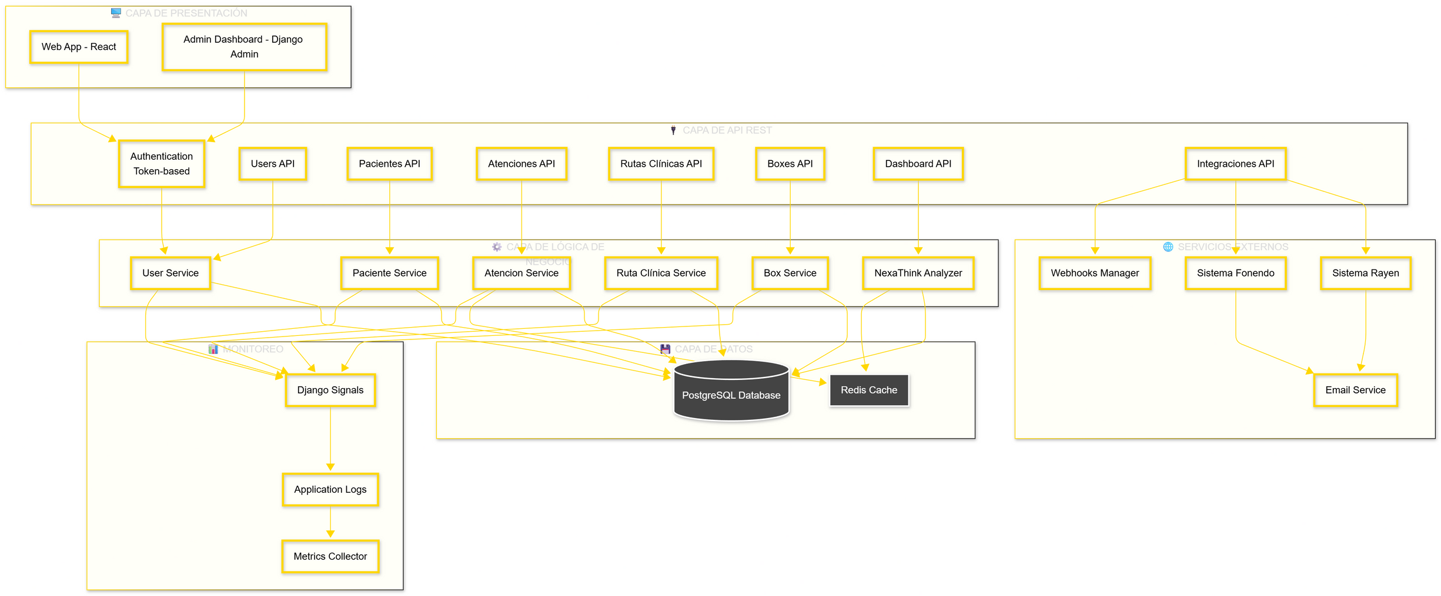
Architecture

Slide 8
Requirements
Display of Available Boxes
Dashboard
Patient Status Display
Current status - Clinical stage - level of urgency
Real-time availability
Real-time graphics
NexaThink - Insights con ML
Patient-Route Synchronization
Analysis with insights
Synchronize stage between patient and their route

Slide 9

SCRUM Methodology
Agile approach to efficient development
The work will be organized into 5 sprints with well-defined backlogs and delivering increments at the end of each iteration.
A methodology that is easy to implement and more convenient for the work team
The Trello tool will be used for work management, documenting user stories.

Slide 10
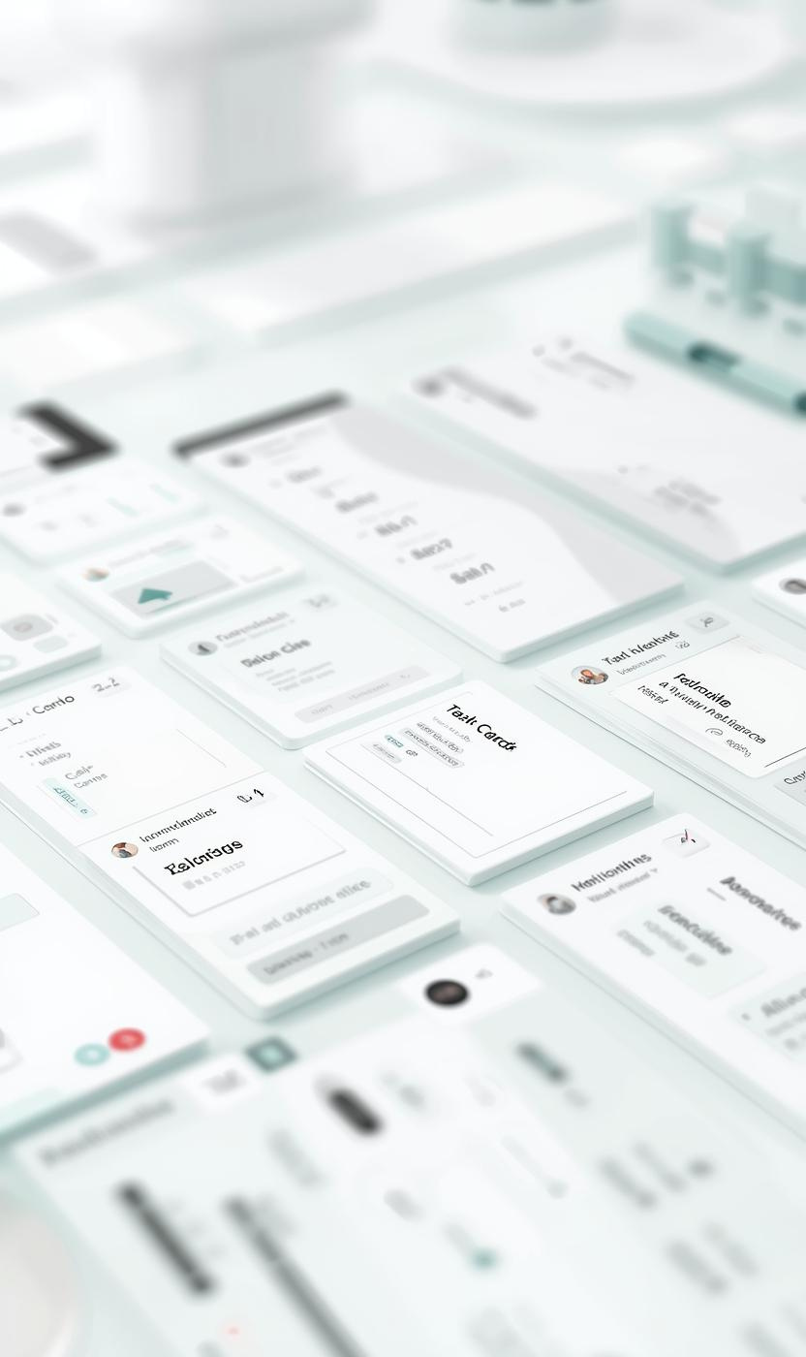



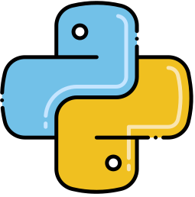


Technologies Used
Communication and Connection
Trello
Notion
Discord
Docker
Frontend
Recharts
React
Backend
Python + Pandas
PostgreSQL
Django y /Django Rest framework

Slide 11


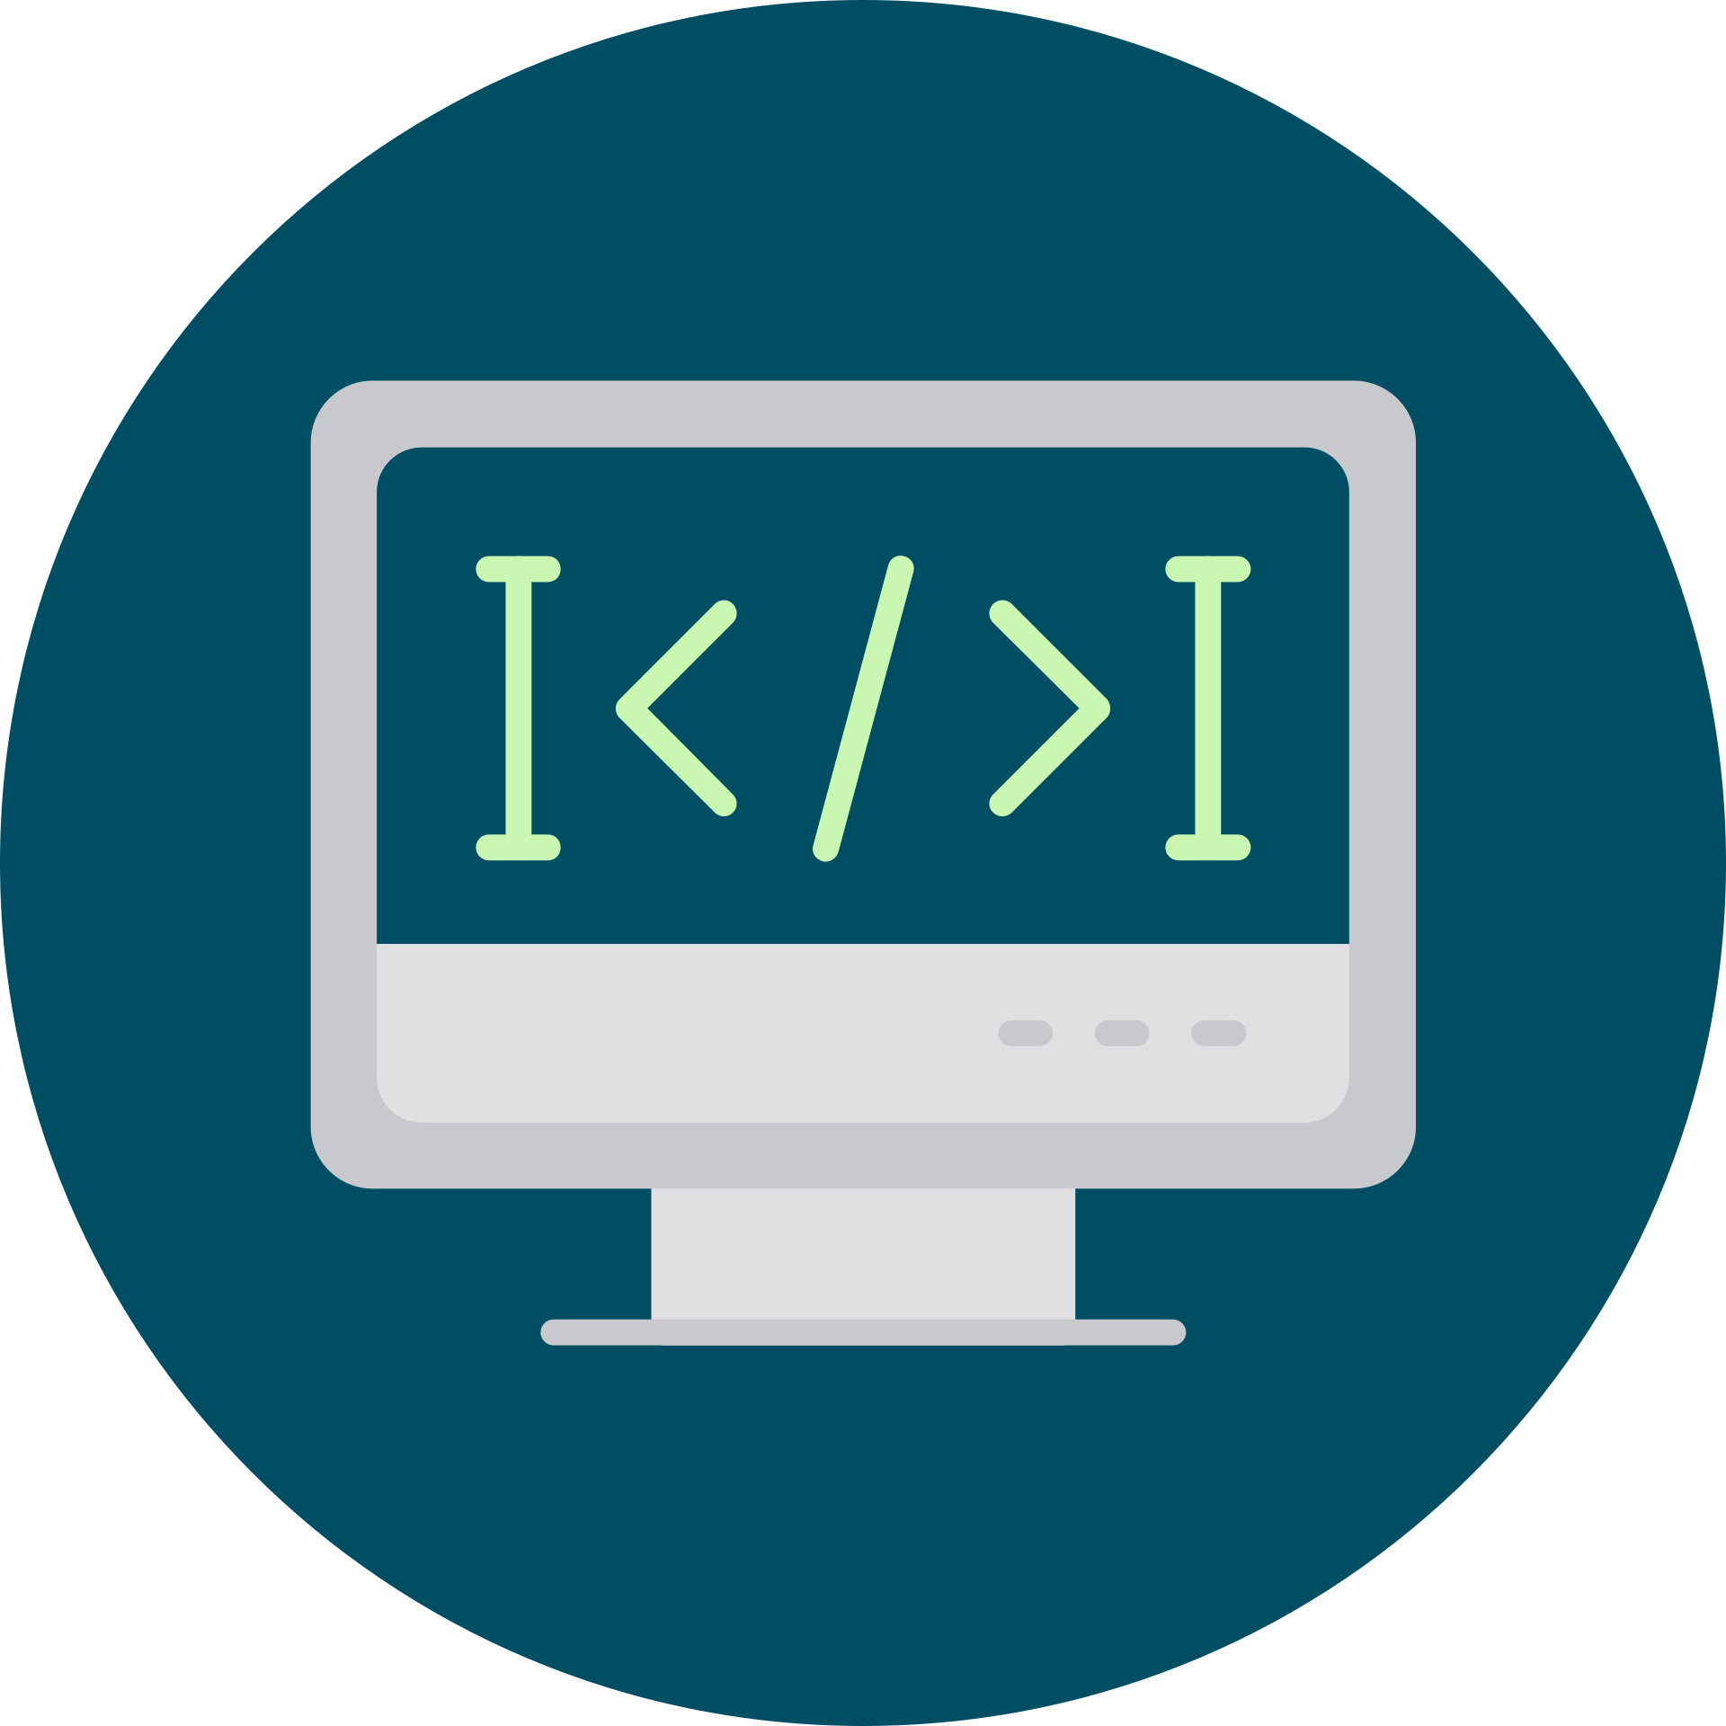
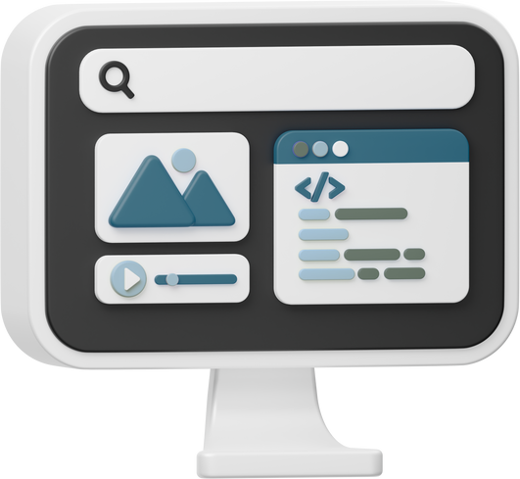

Project Development
Sprint 0:
Planning
Sprint 1:
Documentation
Sprint 2:
Backend
Sprint 3:
Frontend
Sprint 4:
Finalization
The objectives were established and the initial work of the team was organized.
The necessary technical documentation was developed to guide the process.
The server part was implemented and the databases were configured.
The user interface was designed and initial testing was carried out.
Final tests were run and details were adjusted for launch.

Slide 12












Difficulties, Facilitators, and Arrangements
Facilitators
Difficulties
Settings
I work with simulated data
Clear idea
Obtaining real data
Contact and meetings with people in the related field
Conducting tests in a real-world environment
Sprints of 2 to 3 weeks
Effective team communication
Database change to PostgreSQL
Complications with SQLite3

Slide 13
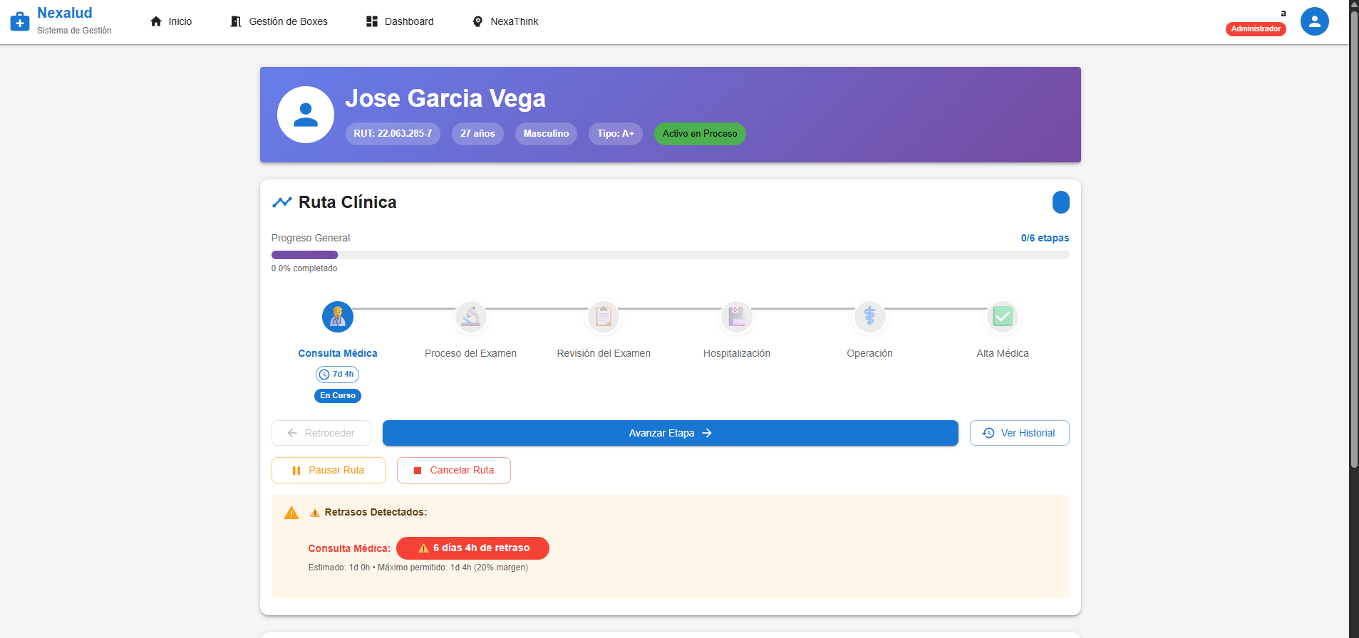
Nexalud Project

Slide 14
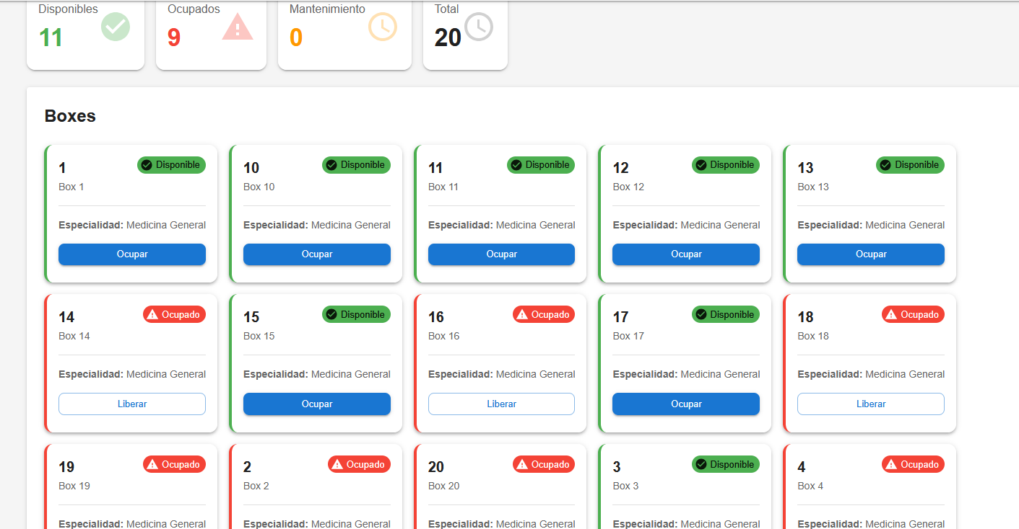
Nexalud Project

Slide 15
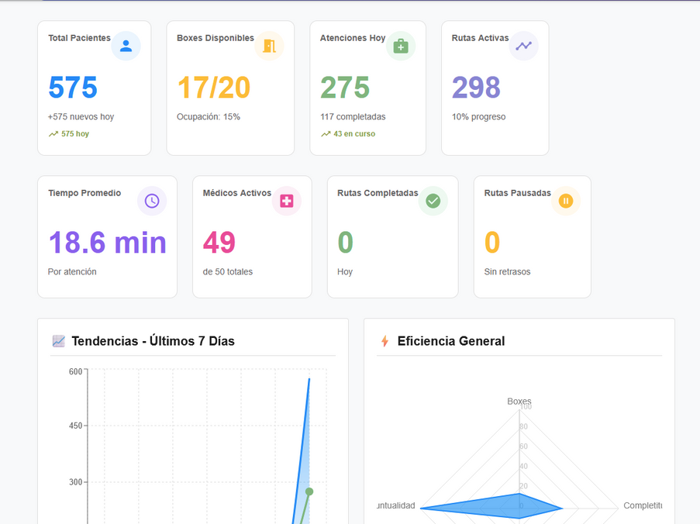
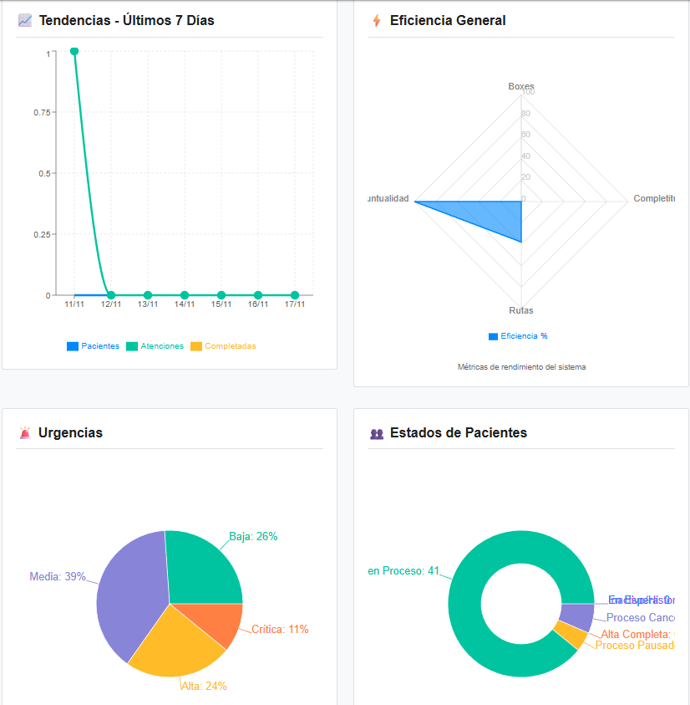
Nexalud Project

Slide 16
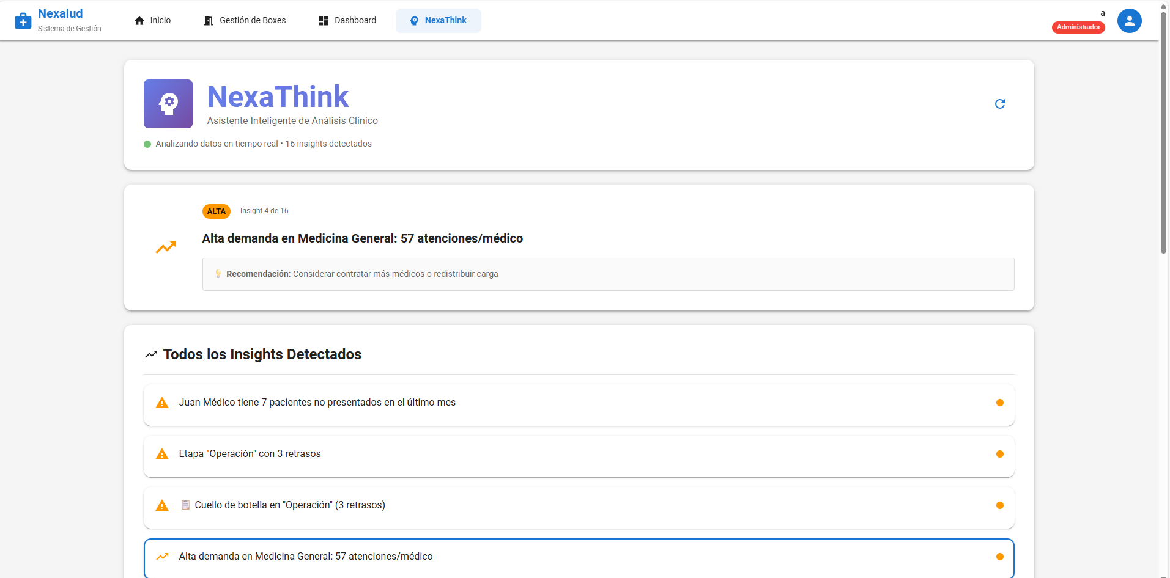
Nexalud Project

Slide 17
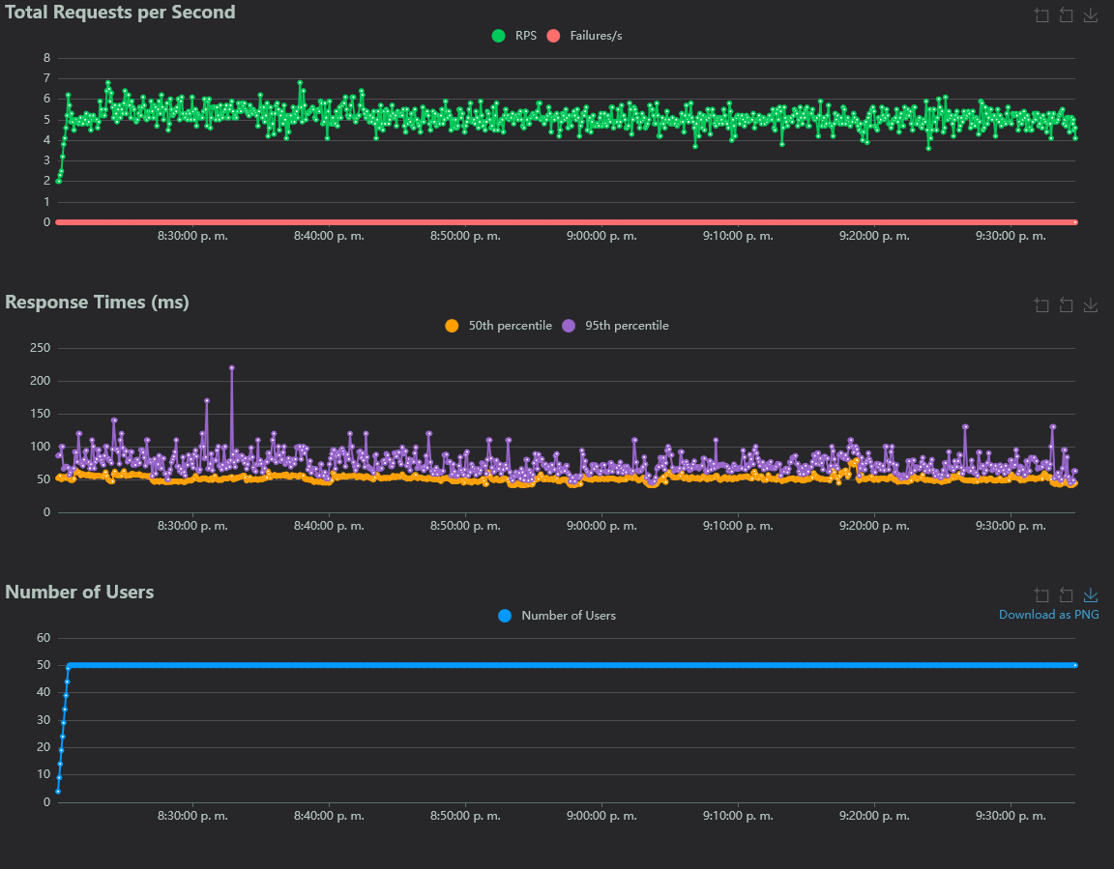
Validations Simulated Tests

Slide 18
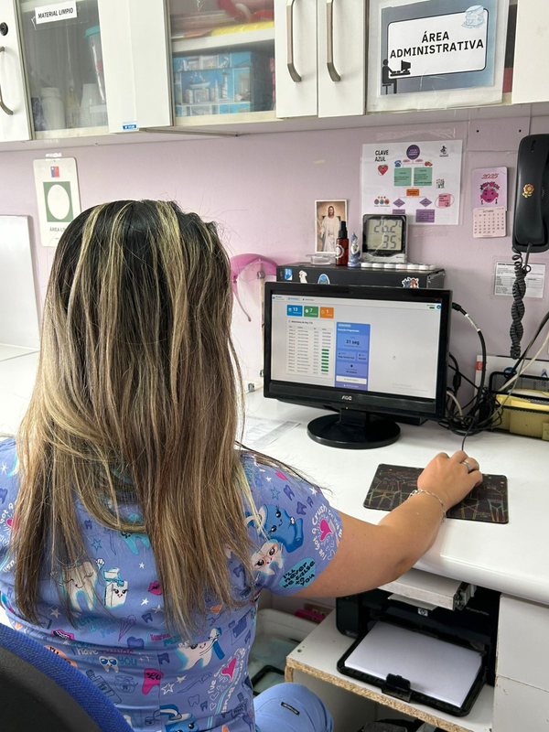
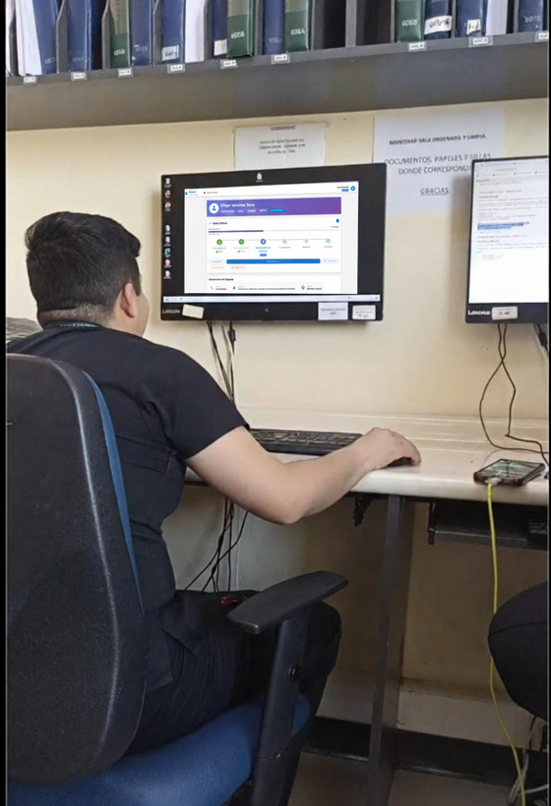
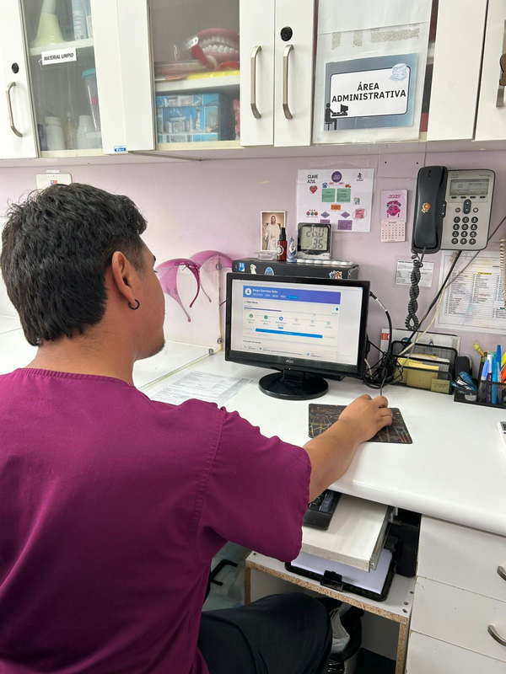
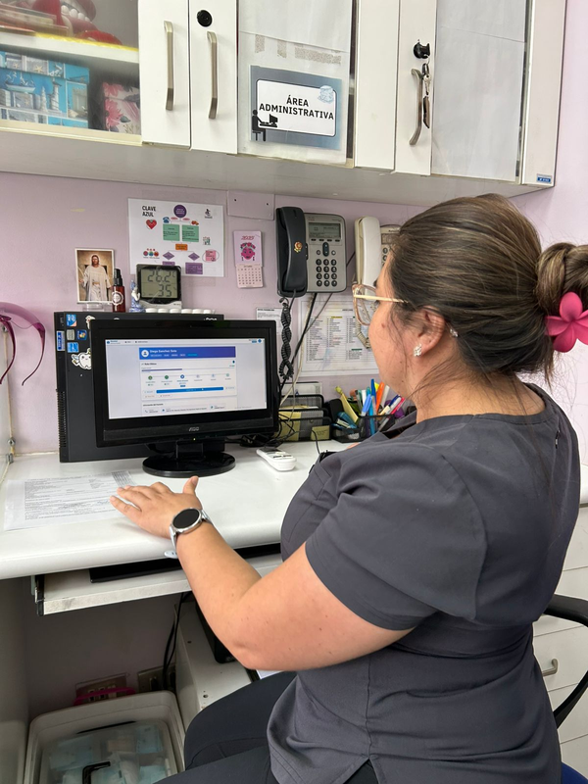
Evidence
Assistant - Cesfam Llay-Llay
Administrative Area - Cesfam Llay-Llay
TENS - Naval Hospital Viña
Doctor - Cesfam Llay-Llay

Slide 19
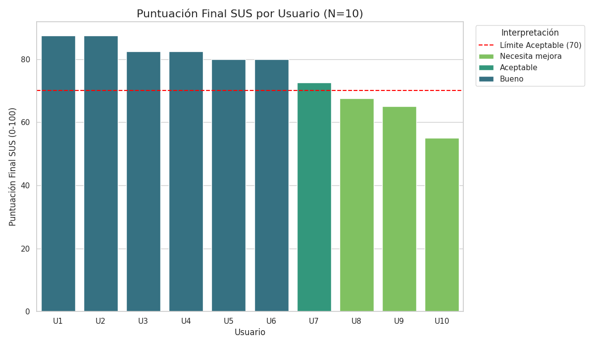

Slide 20

Professional interests and projections
The project aligned with the team's interests in full-stack programming, databases, big data, algorithmic analysis, and machine learning. It allowed them to apply and deepen practical skills in project management, web development, data handling, and real-time visualization.
There was a strengthening in professional development by designing and implementing a complex system that integrates infrastructure, backend, frontend and data analysis.

